Slide 1



SENTIMENT ANALYSIS USING MACHINE LEARNING
ON THE NEW YORK TIMES HEADLINES
Advanced topics in machine learning
Meital Padwa
Bar Mizrahi
Dr. Chen Hagaj

Slide 2


CONTENT
01
NYT PRESPECTIVE ON THE ISRAEL-GAZA WAR
02
ORIGINAL GOALS
03
MACHINE LEARNING TECHNIQUES
04
THE DATA
05
METHODOLOGY
06
RESULTS
07
COMPARISON
08
CONCLUSION

Slide 3





NYT PRESPECTIVE ON THE ISRAEL-GAZA WAR
During the recent ongoing war between Israel and Hamas, there was an extansive backlash from communities around the world, including the U.S citizens.
In this project, we examined the American interest in the October war through the NY Times related articles.
We used machine learning sentiment analysis methods to see whether the writers' opinions are more Pro-Israel or Pro-Hamas .

Slide 4





GOALS
Examine the New York Times tendency regarding Israel
Quantifying the inclination of the NYT writers opinions
Topic analysis of the Articles along the war

Slide 5



MACHINE LEARNING TECHNIQUES
NLTK- provides the tools to build custom sentiment analysis systems. NLTK is used for preprocessing text data and feature extraction before applying machine learning algorithms for sentiment analysis.
WordCloud-Wourdcloud shows the most frequent words bigger and bolder. The bigger the word the more common it is in the text. Great for visualizing keywords in reviews, social media, or any text data
Polarity Scores as Sentiment Analysis- Polarity score refers to the process of quantifying the sentiment or emotional tone expressed in a text. VADER is used as our Polarity score model.
Topic Analysis- technique used to identify abstract topics within a collection of text. The goal of topic analysis is to automatically discover the themes without any prior knowledge of the text

Slide 6
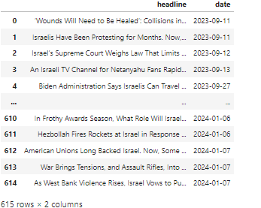
THE DATA
The data contains a list of article headers from September 7, 2023 until January 7th of 2024, along with their date of publish.

Slide 7

METHODOLOGY
USE & CALL API
DATA CLEANING
TOKENIZATION & LEMMATIZATION
EXPLORE AND VISUALIZE DATA.
WORD CLOUD GENERATION
COMPARE SENTIMENT ANALYSIS BEFORE & AFTER CLEANING.
POLARITY SCORE-DRILL DOWN
TOPIC ANALYSIS.

Slide 8

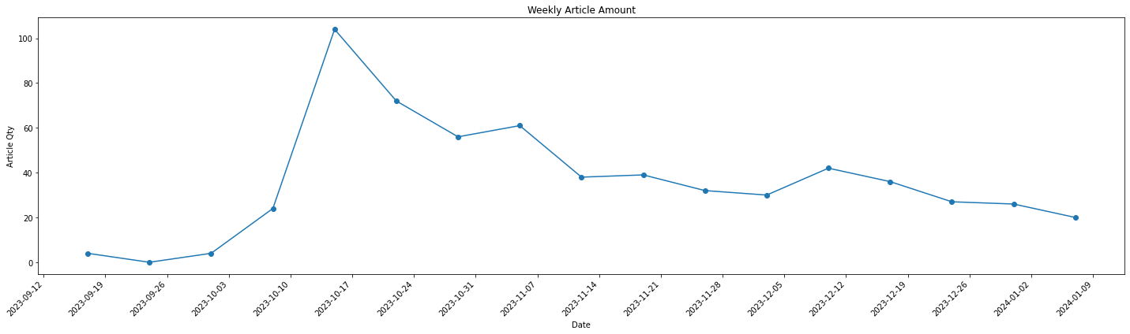
RESULTS
Visual Analysis of the related article amount

Slide 9
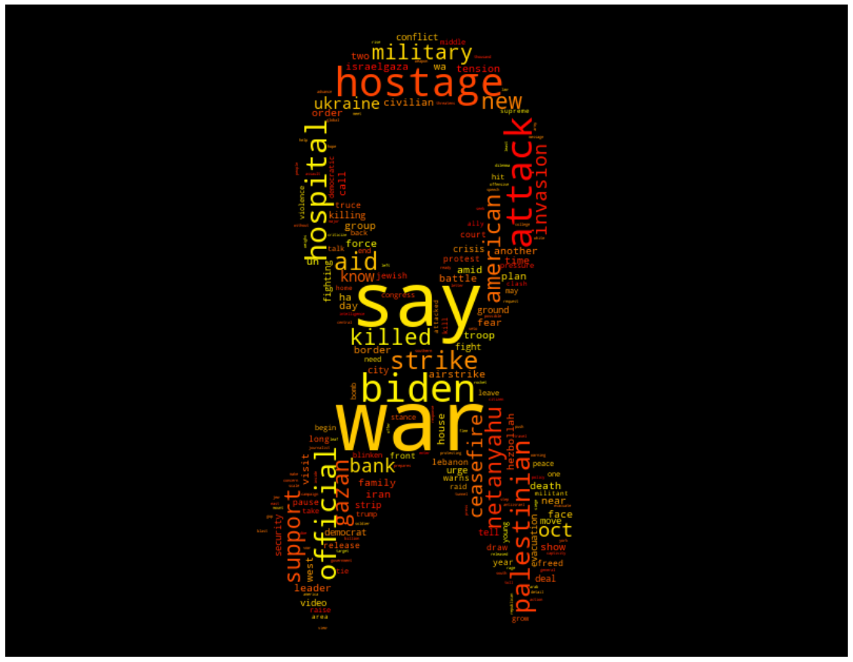
RESULTS
WordCloud- Sentiment analysis

Slide 10
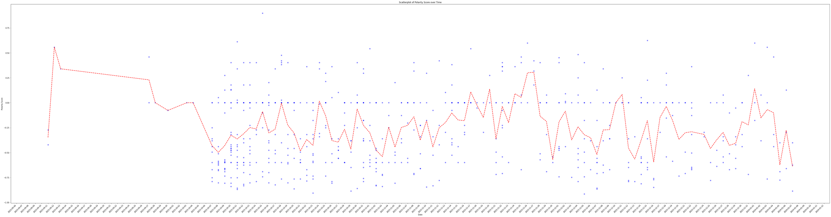
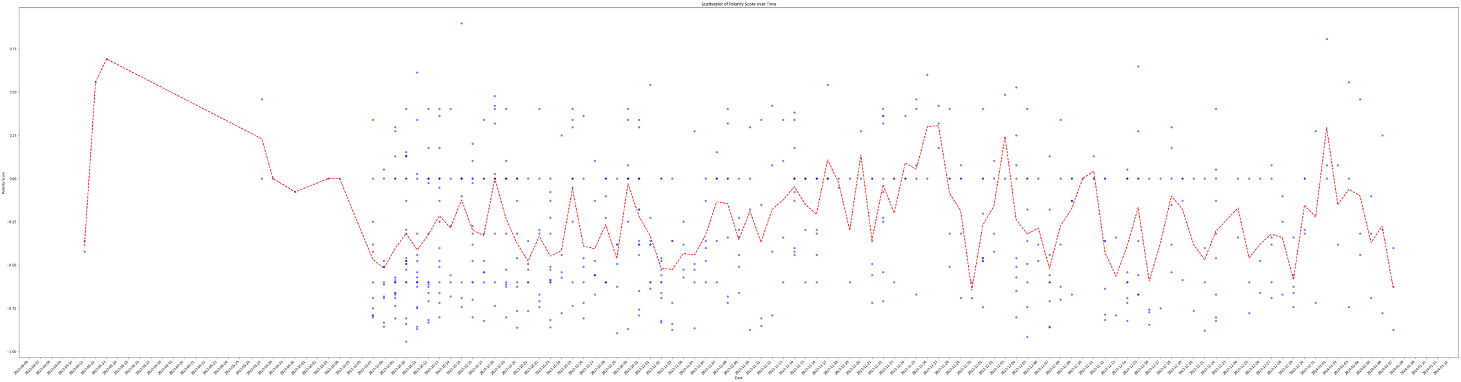
RESULTS
Comparing the sentiment score-
Sentiment analysis
Raw data
Clean data

Slide 11

RESULTS
The positive VS Negative Articles along the timeline
2023-12-03
extend ceasefire, U.S. pressing on resuming talks for truce.
2023-11-17
2023-11-20:
2023-11-26
Israel Displays Tunnel Shaft at Gaza Hospital
First agreement for ceasefire
first batch of hostages was released
2024-01-01
Israel's supreme court struck down the Amendment of the Reasonableness Law
2023-10-10
2023-11-30
2023-10-07
In Unforgiving Terms, Biden Condemns ‘Evil’ and ‘Abhorrent’ Attack on Israel
Shooting in Jerusalem Kills at Least 3 People
surprise attack on Israel

Slide 12
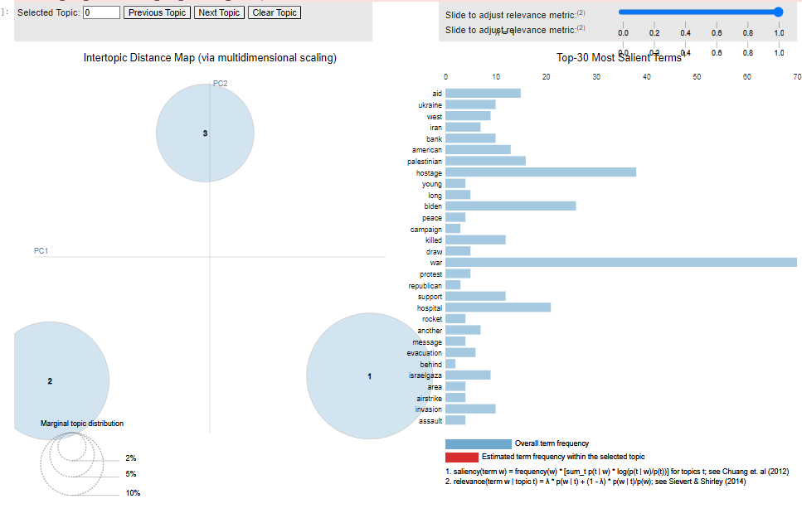
RESULTS
Topic Analysis
Topic 1-
Represents the war. we can see that the most weighted words are "war","attack","oct 7", "strike" ,"killed" etc...
Topic 2-
Represents more political and aid semantics. leading words are "Biden", "aid" , "support", "say" "americans" etc..
Topic 3-
Represents a hostages view. leading words are "hotage", "hospital ," family","release","ceasefire" and "truce" etc..

Slide 13


COMPARISON
During our modeling of the sentiment of the article headers,there were different approaches to the usage of preprocessing the data prior to VADER use in Sentiment Analysis. Some say that it is not recommended to do any preprocessing due to the context consideration and Vader''s lexicon. Others claim otherwise.
We found no difference between the raw data (As it came from the API call) and the clean data (After preprocessing such as Stopwords and panctuation removal, and tokenization).
The reason for the indifference is due to the fact the VADER is a robust model that can handle noise. Preprocessing can only enhance its performance but it may not be needed.
it depends on the context

Slide 14



CONCLUSION
During our modeling of the sentiment of the article headers,it is clear that there is no visible political side taken by the NYT.
The sentiment analysis conceiders some words more negative and does not takes in account the context of the sentence.
Hence, we cannot claim that the NYT are more Pro-Israel nor Pro-Hamas.
The three main topics found with the topic analysis:
Topic 1- Represents the war.
Topic 2- Represents more political and aid semantics.
Topic 3- Represents a hostages view.
In addition, It can be seen that the interest in the ongoing war was at first inclining and then a moderate decrease took place.

Slide 15

THANK YOU
Any Questions?

